Slide 1
Mapping
KELP Forests
Candela Sol PELLIZA | Khizer ZAKIR | María RODRÍGUEZ | Leila MARITIM

Slide 2
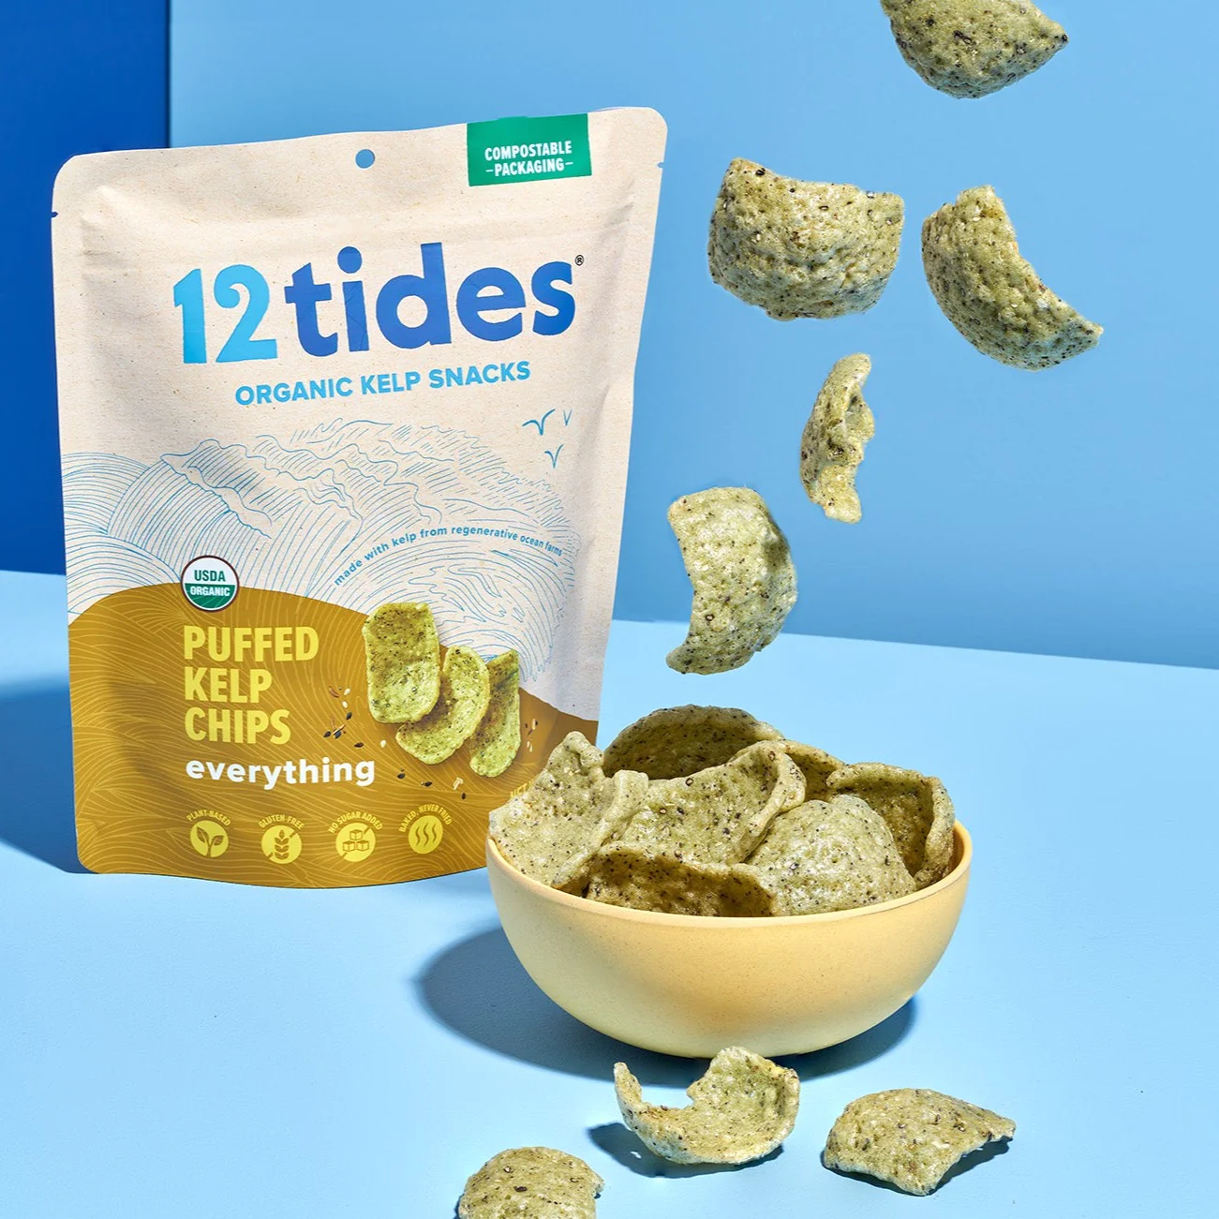
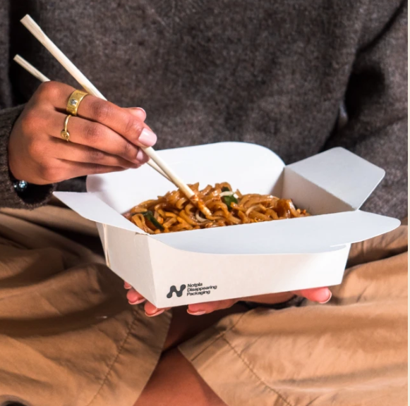
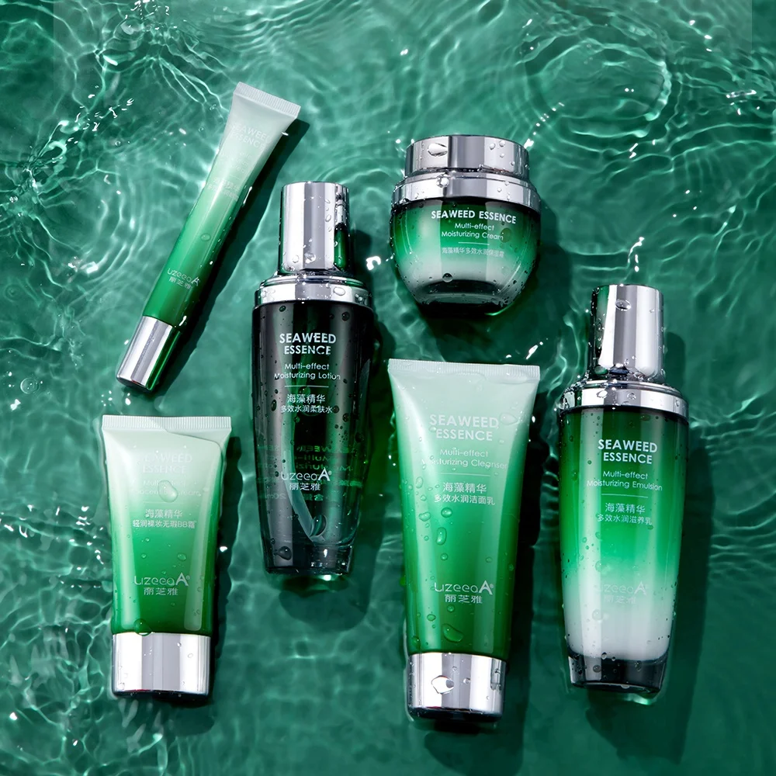
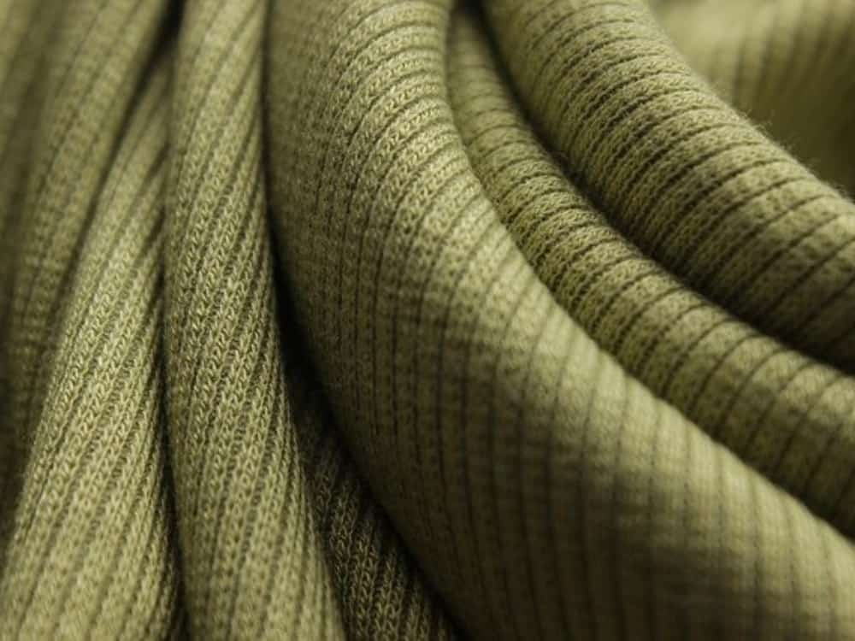
Cosmetics
Fabric
Food
Packaging

Slide 3
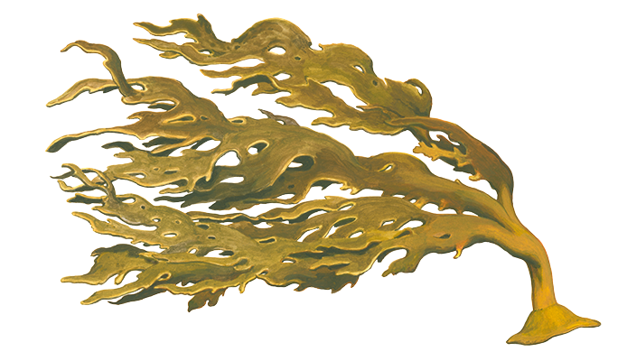
$ 500 BILLIONS
Yearly in ecosystemic contribution

Slide 4
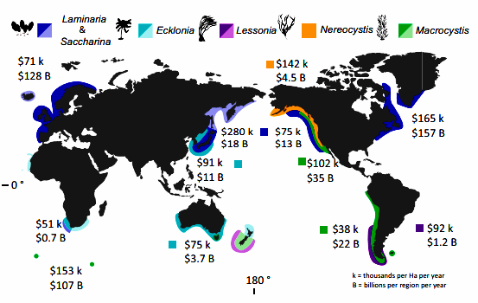
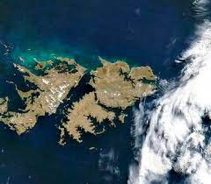
1.8 % of world kelp lost yearly

Slide 5
KELP Wanted - The Challenge
The task: Semantic segmentation of kelp pixels from satellite imagery
Driven Data Test
DATASET
Training
1427 samples
5637 samples
Feature Images
Feature Images
Predicted Labels
SWIR + NIR + R + G + B
+ DEM + Cloud Mask
SWIR + NIR + R + G + B
+ DEM + Cloud Mask
+
Public Leaderboard
Subset of test Labels
DICE SCORE
Ground Truth Labels
Private Leaderboard
Compared Through
All 1427 Labels
Binary Mask
Citizen labeled

Slide 6
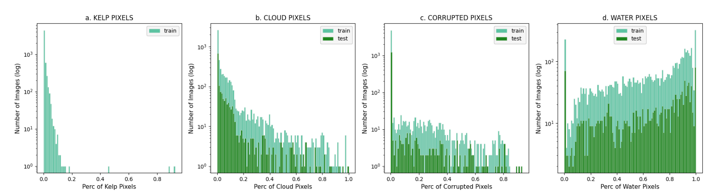
Data Preprocessing and Splitting
1
Data Normalization: excluding 5% extreme values per band (omitting clouds and corrupt pxs)
2
Data Filtering: keep images with kelp presence, < 10% corrupted pixels and <20% cloud cover
3
Stratified Data Split: based on kelp percentage.
3184 samples
0.7 Train | 0.15 Test | 0.15 Val: For experiments and parameter tuning
0.8 Train | 0.20 Val: For training final models for submission

Slide 7
Metrics

Slide 8
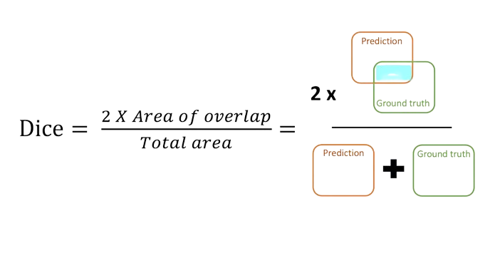
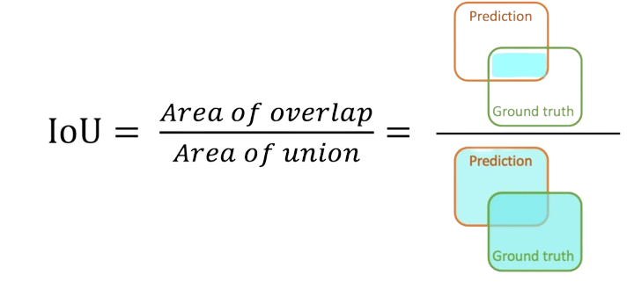
DICE COEFFICIENT & JACCARD INDEX(IoU)
Evaluation metrics to score the similarity between predictions and ground truth.
Values span between 0(worst) to 1(best).
Penalize false positives: A common factor in highly class-imbalanced datasets
IoU penalizes under- and over-segmentation more than DSC.
Other metrics: Precision and recall(sensitivity) and accuracy/rand index.

Slide 9
Experiments

Slide 10
Experiments Workflow Structure
SegNet Baseline
Hyperparameter tuning
Integration of Unet
Evaluation of Loss functions
Test distinct Band Combinations
Rule based Post-Processing
Unet ++ & Final Models Metrics
Anchor Boxes

Slide 11
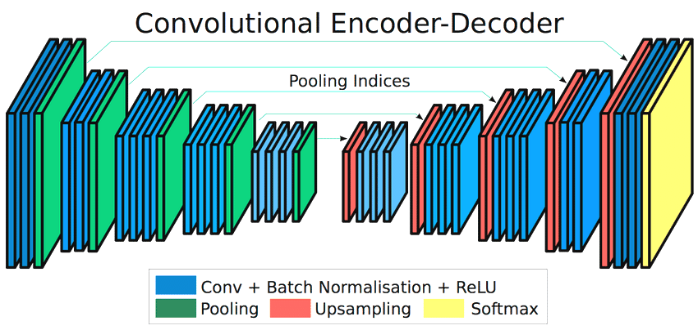
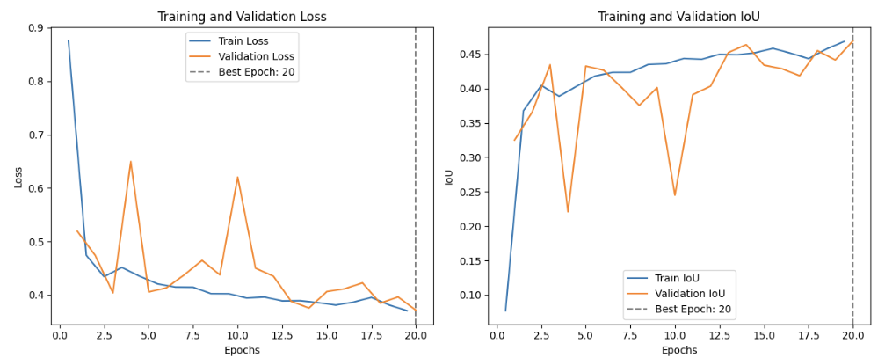
Baseline Model - SegNet
Driven Data Matlab Code → Python
 | Evaluated Values
Bands | Spectral Bands & Canny Edges
Batch Size | 8
Optimizer | Adam
Learning Rate | 0.001
# of epochs | 20
Segnet Architecture proposed by Badrinarayanan et al. (2017)
Approx. size for a 8-batch: 7.12 GB
Dice Score in Public Leaderboard | 0.6426
Min. Eval Loss: 0.3713 - Max. Eval IoU: 0.4694

Slide 12
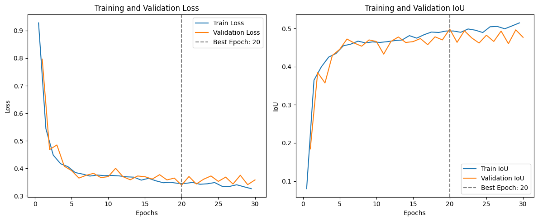

Segnet Baseline Improvement
Hyperparameters
 | Evaluated Values | Selected Value
Batch Size | 8, 16 | 16
Learning Rate | 1e-2, 1e-3, 1e-4 | 1e-4
# of epochs | 20, 50, 80 | 80
Additions
 | Evaluated Values | Selected Value
Early Stopping: Patience | 5, 10 | 10
Weight Decay | 1e-7, 1e-8 | 1e-7
Learning Curves for Segnet Architecture. Driven Data test set approach. Min. Eval Loss: 0.3392 - Max. Eval IoU: 0.4984
Dice Score in Public Leaderboard | 0.6706

Slide 13
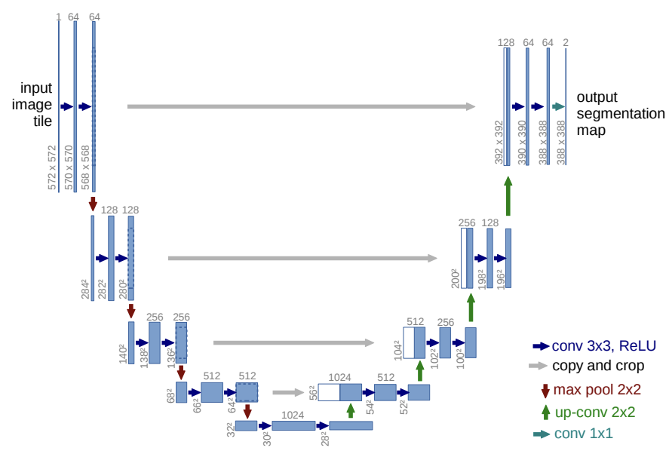
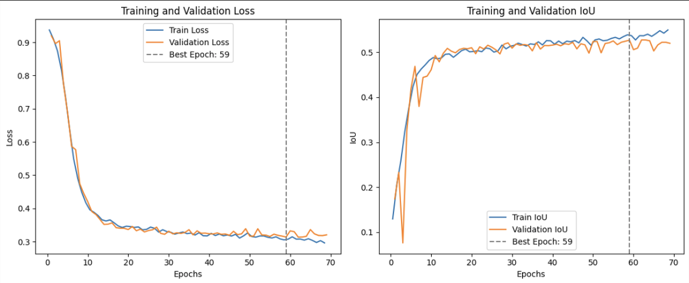
Integration of Unet Architecture
Learning Curves for Unet Architecture. Driven Data test set approach. Min. Eval Loss: 0.3138 - Max. Eval IoU: 0.5269
UNet Architecture proposed by Ronneberger et al. (2015)
Dice Score in Public Leaderboard | 0.6946
Approx. size for a 16-batch : 15.42 GB

Slide 14
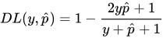
Evaluation of Loss Functions
Cross-entropy
Balance CE
Difference between two probability distributions
Weight the positive and negative classes
DICE loss
Combined loss
1-Dice coefficient
To leverage the flexibility of DICE loss for class imbalance and cross-entropy for curve smoothing
BCE+DICE
CE+DICE

Slide 15
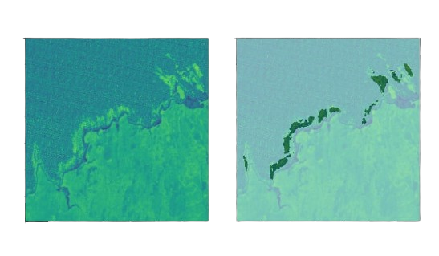
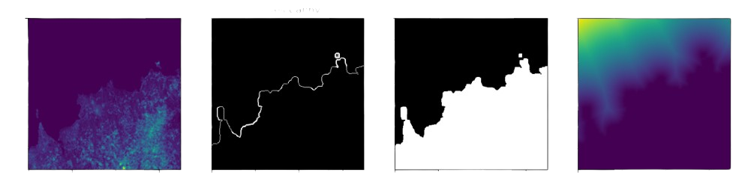
Derived Bands
NDVI maps
Step 1
Step 2
Step 3
Step 4
DEM smoothing and Binarization
Coastline detection
Background mask
Distance computation
Distance maps

Slide 16
Ablation Studies
Testing loss functions
Loss function | Driven Data test set
 | Dice Score Leaderboard
DICE loss | 0.6940
CE + DICE loss | 0.1560
BCE + Dice loss | 0.3786
Testing band combinations
Band combinations | Driven Data test set
 | Dice Score Leaderboard
SB+DM | 0.6946
SB+DM+NDVI | 0.6942
SB+DM+NDVI+DEM | 0.6877

Slide 17
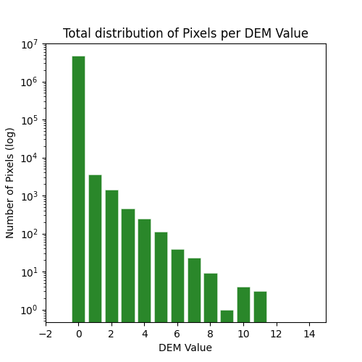
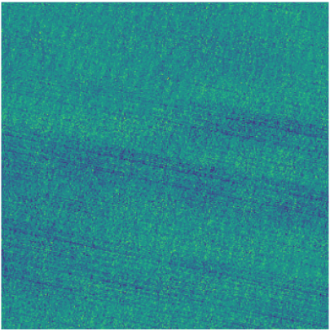


Post processing Workflow
1
DEM: if DEM > 0 pixel = 0
2
Corrupted: if Red = corrupted pixel = 0
3
NDVI: if object mean NDVI < 0 object pixels = 0
Rule-based approach: introducing phenomena specific knowledge
Pixel-based filtering
Object-based filtering
99.5 %
of kelp pixels are located at DEM=0
NDVI
Model Pred
Postprocessed

Slide 18
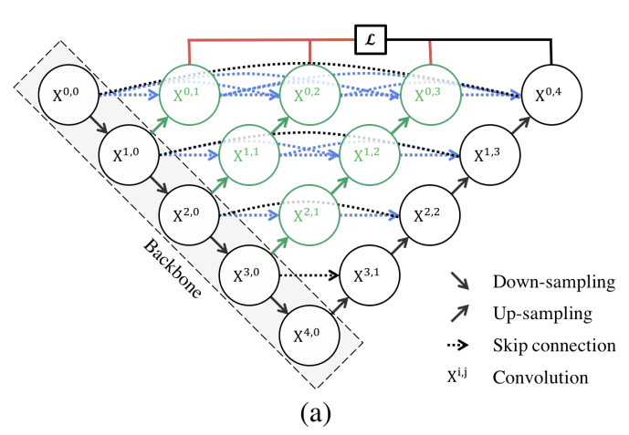
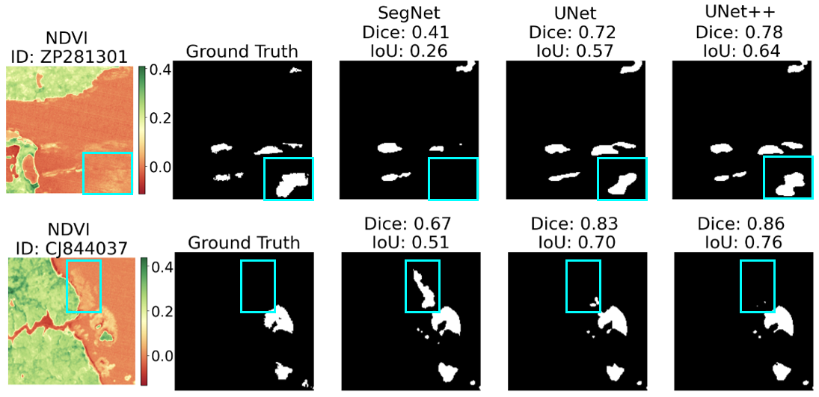
Integration of UNet++ and Final Models Results
 | Segnet | UNet | UNet ++
# of Parameters | 29,445,315 | 31,392,449 | 36,631,361
Final Dice Score in the Leaderboard | 0.6723 | 0.6976 | 0.6945
UNet ++ Architecture proposed by Zhou et al. (2018)
Approx. size for a 16-batch : 32.49 GB
Qualitative assessment of prediction outputs made by the final models in Implemented Test Set

Slide 19
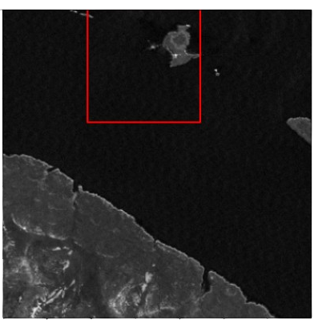
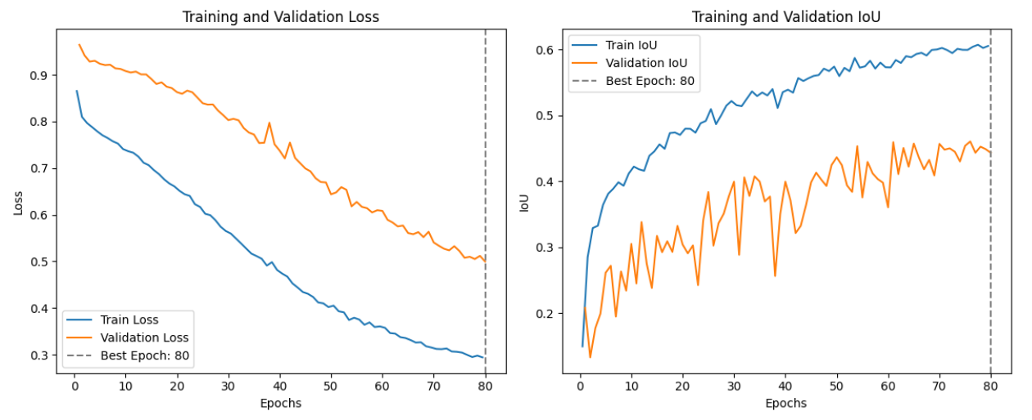
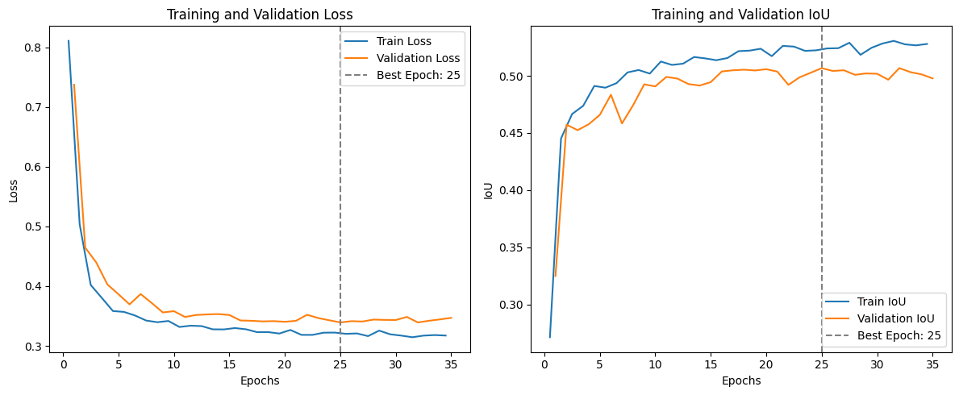
Anchor Boxes
 | Evaluated Values
Scheduler | ExponentialLR
Batch Size | 64, 128
Anchor Size | 128, 160, 224
Learning Rate | 0.01, 0.001
Gamma | 0.5, 0.86, 0.9
128*128 Transform
Stores coordinates of kelp pixels
Dice Score in Public Leaderboard | 0.6779

Slide 20
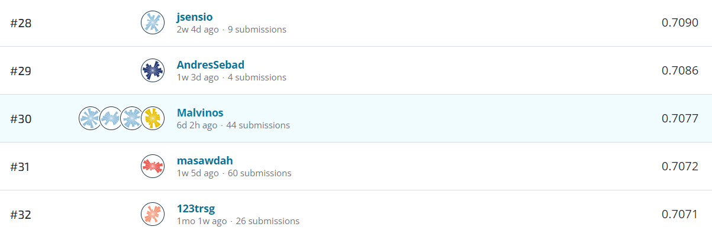
Final Results
Top 5 Results
Public | Private
0.6988 | 0.7077
0.6976 | 0.7077
0.6976 | 0.7075
0.6911 | 0.7067
0.6973 | 0.7063

Slide 21

Thanks!
Do you have any questions?
The processed data and code is publicly available in this repository

Slide 22
References
Badrinarayanan, V., Kendall, A., & Cipolla, R. (2017). Segnet: A deep convolutional encoder-decoder architecture for image segmentation. IEEE transactions on pattern analysis and machine intelligence, 39(12), 2481-2495.
Ronneberger, O., Fischer, P., & Brox, T. (2015). U-net: Convolutional networks for biomedical image segmentation. In Medical Image Computing and Computer-Assisted Intervention–MICCAI 2015: 18th International Conference, Munich, Germany, October 5-9, 2015, Proceedings, Part III 18 (pp. 234-241). Springer International Publishing.
Zhou, Z., Rahman Siddiquee, M. M., Tajbakhsh, N., & Liang, J. (2018). Unet++: A nested u-net architecture for medical image segmentation. In Deep Learning in Medical Image Analysis and Multimodal Learning for Clinical Decision Support: 4th International Workshop, DLMIA 2018, and 8th International Workshop, ML-CDS 2018, Held in Conjunction with MICCAI 2018, Granada, Spain, September 20, 2018, Proceedings 4 (pp. 3-11). Springer International Publishing.

Slide 23
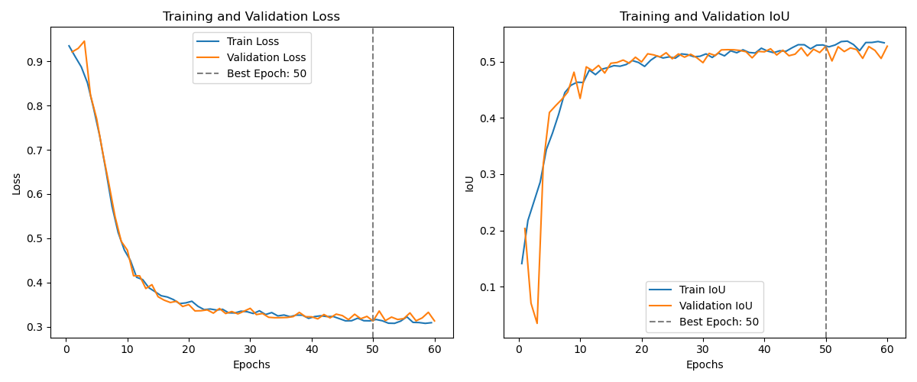
Extra
Learning Curves for Unet++ Architecture. Driven Data test set approach.
Min. Eval Loss: 0.3130 - Max. Eval IoU: 0.5275

